Slide 1
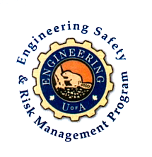
Fundamentals of RM
RM System and Process
Leadership in RM
Incident Investigation
RM Tools & Challenges
RM in Industry
People & Org.
Application and Perspectives
On Becoming a Leader
in Risk Management
ENGG404 - Lecture
Chapter 6.1: Introduction to Technical Safety and Avoiding Catastrophic Loss Incidents

Slide 2
Learning Outcomes:
Explain two different types of loss incidents, and the differences:
Occupational Safety LI
Technical Safety LI
  Chemical Process Safety is a sub-set of Technical Safety
Explain technical safety loss incidents and incident investigations in the context of other engineering disciplines i.e. the catastrophic loss incident.
Apply the concept of technical safety to an industrial example.
Chapter 6.1: Intro to Technical Safety & Avoiding Catastrophic Loss Incidents
2
Notes:
2

Slide 3
Different Types of Safety Concerns and LIs:
Two different types of safety concerns:
Occupational Safety generally refers to the prevention of worker injuries, such as prevention of trips, slips and falls.
Technical Safety includes the prevention of loss of control or an unintentional release of some form of energy.
Chemical Process Safety is a specialized sub-set.
Thus it follows that there are two different types of loss incidents:
Occupational Safety LI:
Technical Safety LI:
Loss of control
Loss of integrity of the design intent of the engineered system
Unintentional or uncontrolled release of some form of energy
Extremely low likelihood but with catastrophic consequences!
Note that most government agencies do NOT differentiate between these two kinds of loss incidents – any injury in the workplace regardless of the nature of the loss incident is classified as an “occupational injury”.
Chapter 6.1: Intro to Technical Safety & Avoiding Catastrophic Loss Incidents
3
Notes:
3

Slide 4
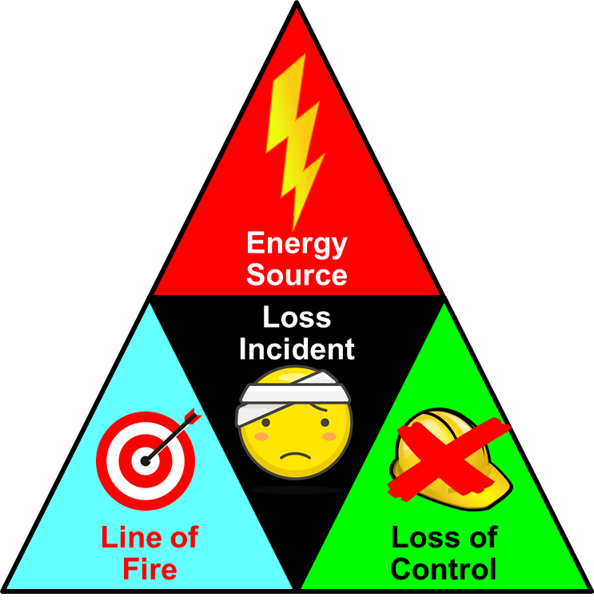
Technical Safety Hazard and The Incident Models:
Technical Safety Hazard:
Definition - typical “technical hazard” or “technical safety hazard” that may lead to a “technical safety loss incident”:
  Asset: Physical situation where the activity is taking place
  (i.e. the facility, equipment)
  Potential Impact: Harm or damage to PEAP
  Loss of Control (Trigger): A loss of control that resulted in a release of energy
  Energy Source: Nature of energy or nature of materials
  (shock hazard, momentum/motion, flammable, combustible, etc.)
The general definition of a technical safety hazard and the two incident models lead to an understanding that “technical safety” is NOT limited to chemical unit process operations i.e. any “catastrophic loss incident”!
Now, recall the Incident Models, the Discovery Approach and
relate these to any catastrophic loss incident!
Chapter 6.1: Intro to Technical Safety & Avoiding Catastrophic Loss Incidents
4
Notes:
4

Slide 5
Example: Technical Safety, RCA, & The Discovery Approach:
Applications of Technical Safety:
Incident: “Crane collapsed, crushing people below crane”
Definition: “technical safety hazard”:
  Asset: ?
  Potential Impact: ?
  Loss of Control (Trigger): ?
  Energy Source: ?
Discovery Approach:
  Energy Source?
  Line-of-Fire?
  Loss of Control?
Crane collapsed, crushing people below crane
?
?
?
?
Energy Source:
?
Loss of Control:
?
Line-of-Fire:
?
Loss of Control:
?
Chapter 6.1: Intro to Technical Safety & Avoiding Catastrophic Loss Incidents
5
Notes:
5

Slide 6
Technical Safety, RCA, and The Discovery Approach:
Applications of Technical Safety:
Incident: “Crane collapsed, crushing people below crane”
Typical “technical safety hazard” definition:
  Asset: crane
  Potential impact: people crushed
  Loss of Control (Trigger): Wind loads exceed spec’ns
  Energy Source: Gravity
Discovery Approach:
  Energy Source?
  Line-of-Fire?
  Loss of Control?
Indeed, a crane collapse is a catastrophic LI akin to a refinery explosion.
Crane collapsed, crushing people below crane
Crane fell to ground level
Wind forces exceeded crane strength
People were below the crane
Barriers did not keep people out of area
Energy Source:
gravity
Loss of Control:
excessive wind loads
Line-of-Fire:
People below crane
Loss of Control:
Barriers not in place
Chapter 6.1: Intro to Technical Safety & Avoiding Catastrophic Loss Incidents
6
Notes:
6

Slide 7
ALE #1: Technical Safety – Not Just for Chemical Engineers!
Each field of engineering has its equivalent catastrophic failure!
The scope of Technical Safety goes beyond the chemical process industries.
Important concept for ALL engineering disciplines!
Causes may be different, but it is a loss of control i.e. the loss of the integrity of the design intent of the engineered system that would have the equivalent magnitude or impact of a “chemical process safety” incident e.g. refinery fire
Examples:
  The loss of containment (loss of something you want physically contained).
  The collapse of a structure.
  The disintegration of a machine.
Please confer (chat with team, Open discussion):
What was the nature of the catastrophic failure for your team project loss incident i.e. the “technical safety LI”?
Example “ChE: refinery fire” (this is a typical chemical process safety loss incident).
Chapter 6.1: Intro to Technical Safety & Avoiding Catastrophic Loss Incidents
7
Notes:
7

Slide 8
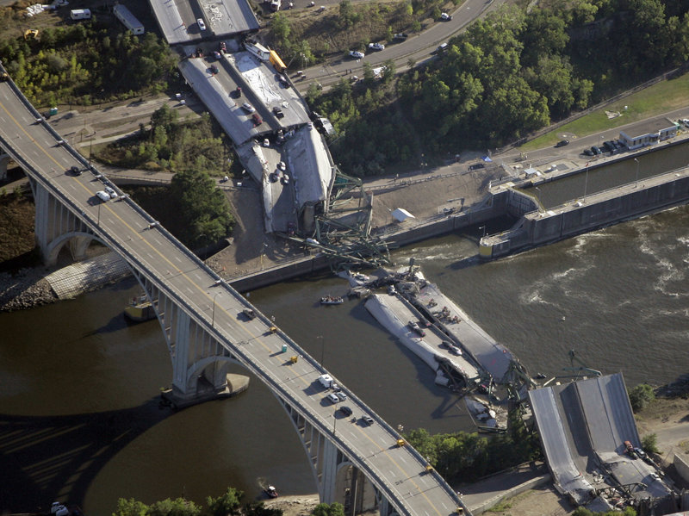
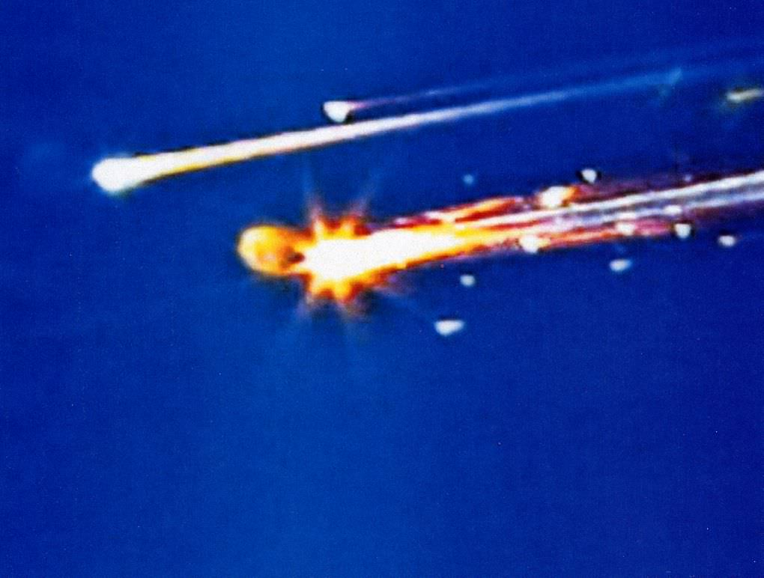
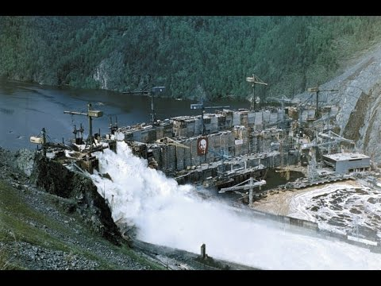
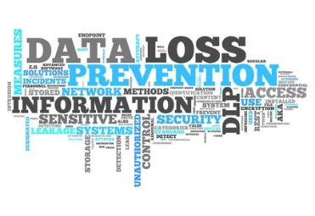
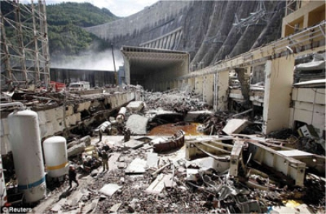
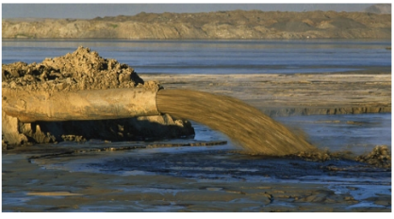
Technical Safety – Not Just for Chemical Engineers!
The loss of the integrity of the engineered system that would have the equivalent magnitude or impact of a “chemical process safety loss incident” i.e. an equivalent catastrophic failure!
Loss of Containment:
Tailings from a tailings pond
Sewage from a sludge line
Private / secured data breach
Hydrocarbons from a train car
Slope failure of a quarry or roadway
Loss of Integrity of Eng’d Systems:
Aerospace: Boeing 737MAX,
STS Challenger & Columbia
Marine: off-shore BP-DWH
Civil: Bridges, buildings, dams, cranes
Transportation: Train derailments
Automotive / Computer Process Control:
Takata airbags, Tesla self-driving vehicles
Chapter 6.1: Intro to Technical Safety & Avoiding Catastrophic Loss Incidents
8
Notes:
8

Slide 9
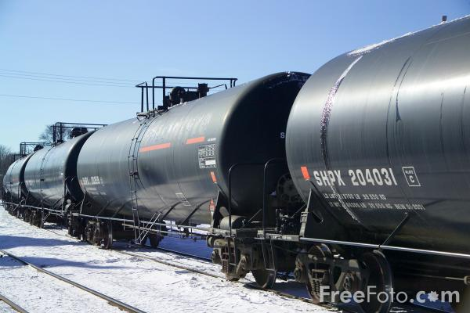
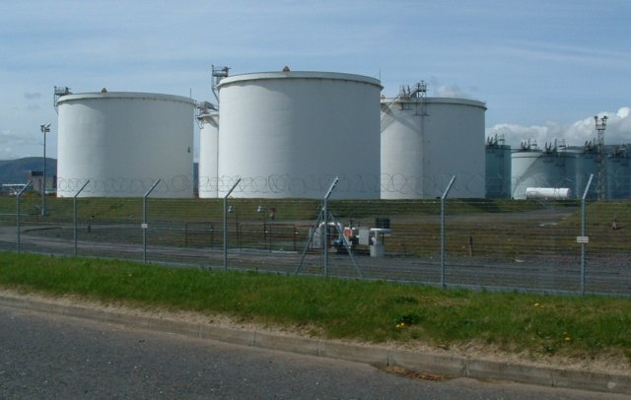
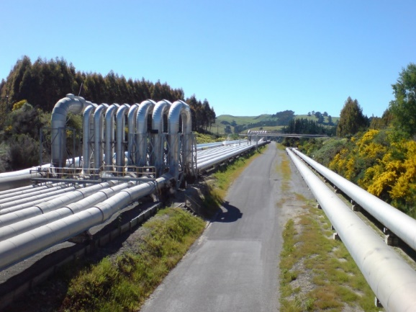
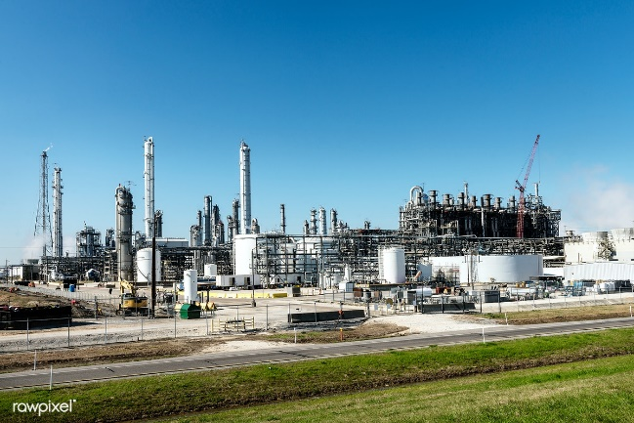
Chemical Process Safety – Not Just for Chemical Engineers!
All fields of engineering involved in Chemical Process Safety LIs!
Investigations require expertise of many engineering disciplines (mechanical, civil, electrical, etc.)
Chemical Process Safety Management and specialized risk assessments require expertise: Design, Constructability, Operability, Maintenance, Process Control, Fire Protection, and so on.
Chapter 6.1: Intro to Technical Safety & Avoiding Catastrophic Loss Incidents
9
Notes:
9

Slide 10
Immediate Causes of Chemical Process Safety Loss Incidents
The potential immediate causes of chemical process safety incidents are innumerable:
“Normalization of Deviance”
Not addressing process equipment that is in imminent failure mode, a sub-standard condition.
Bypassing alarms or taking control systems offline.
Tolerance for substandard practices for critical procedures.
Chapter 6.1: Intro to Technical Safety & Avoiding Catastrophic Loss Incidents
10
Notes:
10

Slide 11
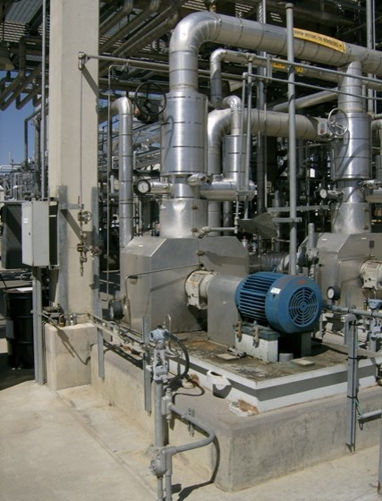
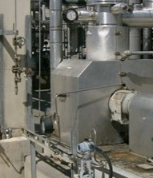
Small Diameter Tubing – Industrial / Refinery Installations:
Consider small-diameter process tubing that is commonly used in many industrial process unit operations, as depicted here.
Chapter 6.1: Intro to Technical Safety & Avoiding Catastrophic Loss Incidents
11
Notes:
11

Slide 12
Two Incidents Involving Tubing Failure:
Incident 1:
Caused by ½-inch stainless steel tube between a heat transfer fluid (antifreeze, combustible) pump and a process vessel failed at a fitting near the process vessel.
The resulting leak sprayed onto a re-boiler, very hot surfaces, and ignited causing significant equipment damage.
The tubing failure was the result of uncontrolled vibration the pump.
Incident 2:
Gas leak from ½-inch tubing for pump seal was detected during LNG (Liquefied Natural Gas) plant startup.
Deficient repairs done by unqualified technician.
When the plant re-started, tubing failed completely causing an LNG leak and fire.
As the engineer responsible for these LI’s, what would you do?
Chapter 6.1: Intro to Technical Safety & Avoiding Catastrophic Loss Incidents
12
Notes:
12

Slide 13

Two Incidents Involving Tubing Failure:
What should we do?
Tubing may not be as durable as pipe and may be more easily damaged.; therefore, avoid impacts to tubing and tubing connections.
Report damaged or leaking tubing observed in the plant and repair it. Report & correct sub-standard conditions i.e. “see it - own it – solve it”.
For design, installation, operation, maintenance:
Follow procedures for tubing identification and isolation for work.
Review procedures for installation, inspection, & maintenance of tubing.
Use qualified personnel to install and repair tubing.
Use correct tools for installation and maintenance of tubing.
Use correct components – tubing, ferrules, nuts,
and fittings - do not mix components from different
manufacturers.
Ask your tubing supplier to provide information on
proper installation and maintenance of their product.
But it is not just about “using the right technology” …
Use your leadership skills to actively practice
your technical safety expertise to demonstrate
commitment and set the example!
Chapter 6.1: Intro to Technical Safety & Avoiding Catastrophic Loss Incidents
13
Notes:
13

Slide 14
ALE #2: Mechanical Integrity of Tubing
Tubing, including metal, plastic, rubber, and other materials, is commonly used in process plants.
Where do we use tubing?
Could failure of a tubing system result in a chemical process safety LI?
Please confer and respond (MM-Poll):
What is a “loss of control (trigger)” that could result in a failure of tubing integrity and a loss incident?
Chapter 6.1: Intro to Technical Safety & Avoiding Catastrophic Loss Incidents
14
Notes:
14

Slide 15
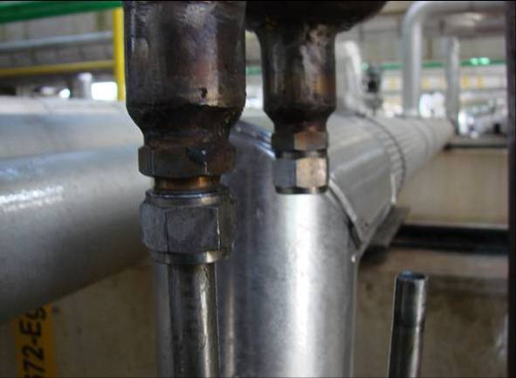
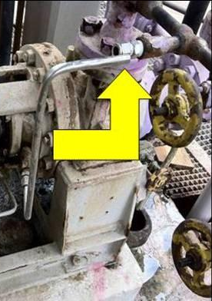
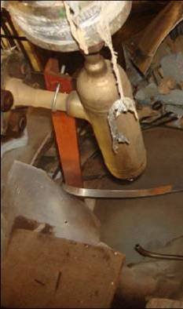
Example: Mechanical Integrity of Tubing
Sub-standard conditions can be found during inspections on:
For instrument fluid connections: To flush pump and agitator seals, for other applications with small flow requirements e.g. density meters
For conduit connections: instrument signals, electrical power supply
Example: improper assembly
Loss of Control:
vibration fatigue failure; misalignment stress – forced fit or struck by;
wrong fitting loosened (also a sub-standard practice)
Release of Energy:
Fluid or electricity!
Chapter 6.1: Intro to Technical Safety & Avoiding Catastrophic Loss Incidents
15
Notes:
15

Slide 16
Example: The Discovery Approach and Your RCA:
Apply the Discovery Approach to Your Team Project Loss Incident to start your RCA Chartefinition: “technical safety hazard”:
  Asset: ?
  Potential Impact: ?
  Loss of Control (Trigger): ?
  Energy Source: ?
Discovery Approach:
  Energy Source?
  Line-of-Fire?
  Loss of Control?
Your incident description
?
?
?
?
Energy Source:
?
Loss of Control:
?
Line-of-Fire:
?
Loss of Control:
?
Chapter 6.1: Intro to Technical Safety & Avoiding Catastrophic Loss Incidents
16
Notes:
16

Slide 17
Summary and Key Lesson:
Differences between Occupational Safety LI and Technical Safety LI:
  Magnitude of the impacts on PEAP as technical safety incidents are typically at least an order of magnitude worse than occupational safety incidents.
  Occupational Safety LI: a worker was injured during the course of physical labour
  Technical Safety LI: loss of control i.e. loss of the integrity of the design intent of the engineered system; this usually results in a catastrophic LI
  Chemical Process Safety is a specific sub-set of Technical Safety; process safety management is about keeping hazardous substances contained and/or controlled (prevention of release, mitigation in event of a release).
  Catastrophic LI’s are NOT unique to the chemical process industries.
  Technical safety and process safety are not just for chemical engineers!
An investigation into any technical safety incident requires the expertise of various engineering disciplines (mechanical, civil, electrical, etc.)
Chapter 6.1: Intro to Technical Safety & Avoiding Catastrophic Loss Incidents
17
Notes:
17

Slide 18
Any questions?
Notes:
18

